Slide 1

Credit Rating Agencies
By Ayoub DAOUD & Issa KACHAOU

Slide 2
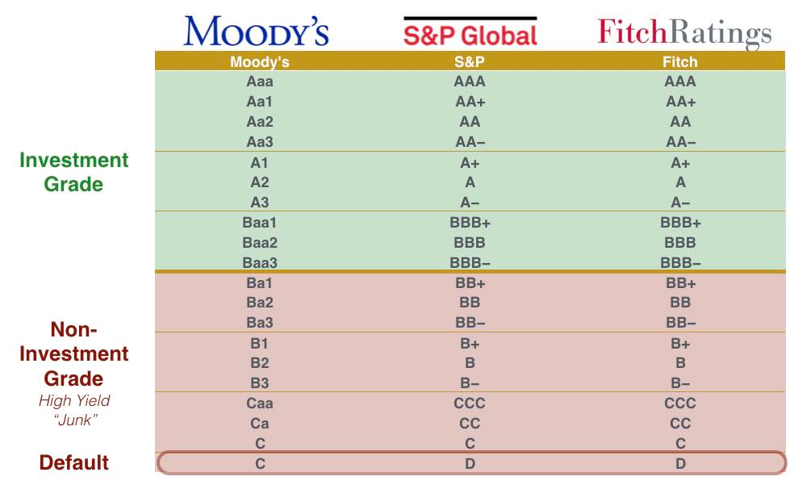
1. Introduction to Credit Rating Agencies
Credit rating agencies (CRAs) assess the ability of borrowers—companies, states, or local authorities—to repay their debt.
The main agencies include:
Moody's Investor Service (Moody's)
Fitch Ratings (Fitch)
Standard & Poor's (S&P)
Scope Ratings, a European agency, was recently approved by the European Central Bank.

Slide 3
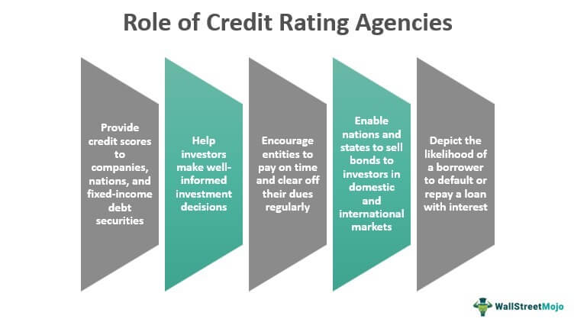
2. The Role of CRAs
CRAs evaluate the risk premium associated with debt, which influences interest rates. The highest rating is AAA.
CRAs emerged in the 1920s, focusing on credit quality post-1929 crisis.
Financial scandals like Enron and the subprime crisis revealed risks in their assessments.

Slide 4
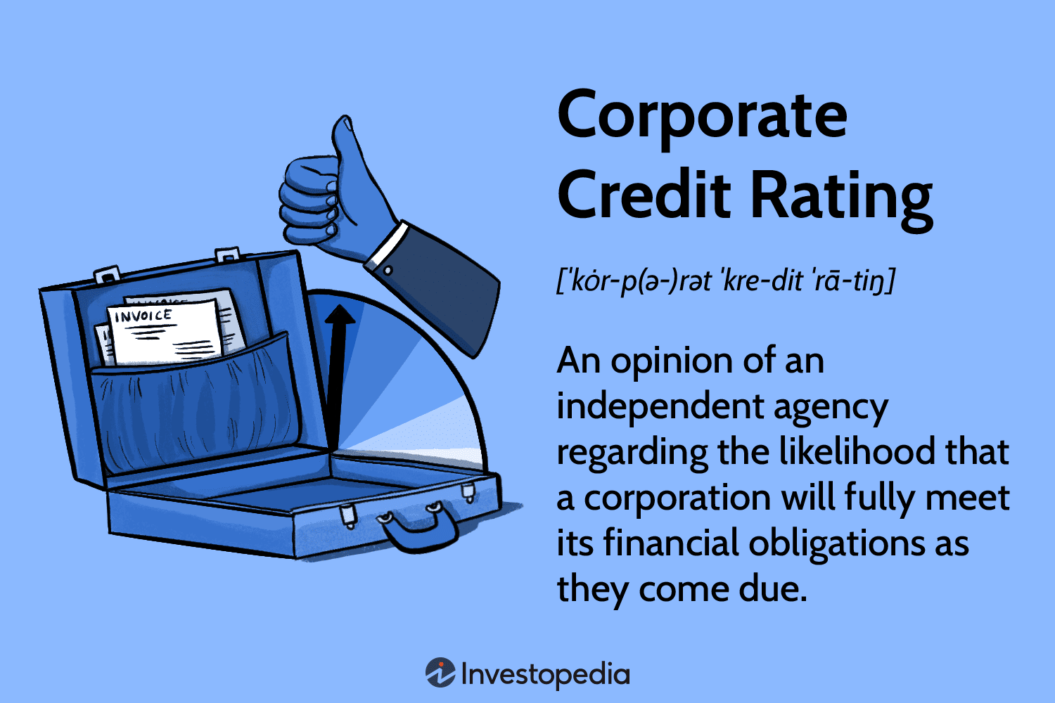
3. Credit Ratings Explained
Credit ratings assess a borrower's risk of default. Key criteria include:
Financial profitability
Return on invested capital
Debt levels
Financial flexibility
Liquidity
Non-quantitative criteria like governance and corporate social responsibility are increasingly important.

Slide 5
4. Importance of Ratings
Ratings influence a company’s ability to secure financing. Higher ratings lead to lower interest rates.
For example, France's rating was downgraded to "AA-" by Fitch in April 2023.

Slide 6
5. Criticisms of Rating Agencies
Criticisms include:
Conflicts of interest due to the issuer-pays model.
Lack of transparency in rating methodologies.
Failure to predict declines in borrower solvency.
The EU has implemented regulations to improve oversight and transparency since the 2008 crisis.

Slide 7
Conclusion
Rating agencies play a critical role in financial markets, but they face significant scrutiny and regulatory challenges.

